Slide 1


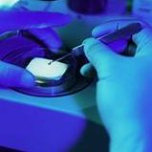

Puma Biotechnology
First Quarter 2026 Earnings Call
May 7, 2026

Slide 2
ALISCATM-Breast1 (PUMA-ALI-1201)
Interim Analysis
May 7, 2026

Slide 3
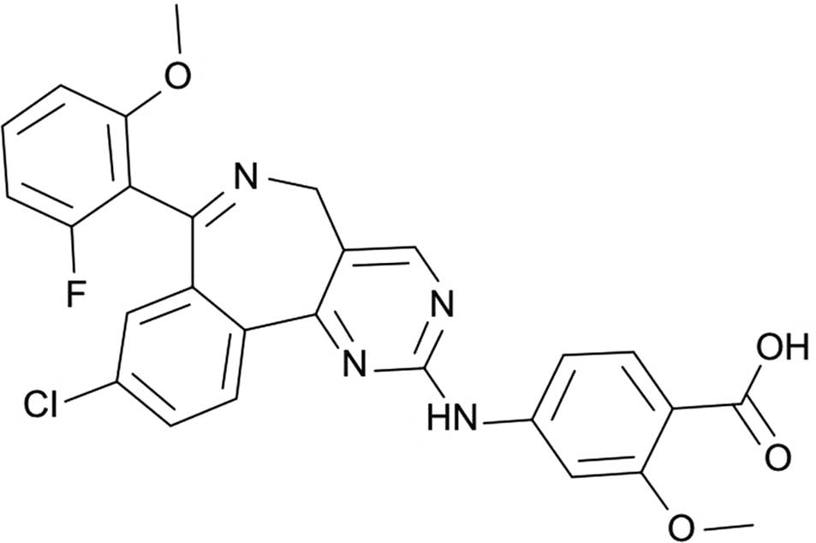
Alisertib (MLN 8237)
Orally Bioavailable
Drug Class: Benzazepine
Aurora Kinase A (AURKA) inhibitor
Single-agent and combinational clinical activity in solid tumors including hormone receptor-positive breast cancer (HR+ MBC), triple negative breast cancer (TNBC), small cell lung cancer (SCLC), and head and neck cancer
Single-agent clinical activity in hematologic malignancies including peripheral T-cell lymphoma (PTCL) and aggressive non-Hodgkin’s lymphoma (NHL)
Well-characterized safety profile: ~1,300 patients treated across 22 company-sponsored trials

Slide 4
AURKA and c-Myc Co-regulate Each Other
Nuclear AURKA exerts kinase-independent functions by acting as a transcription factor
AURKA
c-Myc
Genomic instability & tumor development
AURKA and c-Myc transcriptionally upregulate each other, suggesting the existence of a positive feedback loop
c-Myc upregulates Cyclin D2, CDK4, and cyclin-E, contributing to complex formation and subsequent phosphorylation of p27Kip1, which leads to cell proliferation
E2F1
cyclin-D2
cyclin-E
cdk4
cdk2
P
p27^{klp1}
Cell proliferation
Naso FD Oncogene 2021, Tang A Oncotarget 2017

Slide 5

ALISCA™-Breast1
Phase II dose optimization, biomarker evaluation in HR+/HER- MBC
Key inclusion criteria:
HR+/HER2- mBC patients who have received at least 2 prior lines of endocrine therapy in the recurrent or metastatic setting
  Must have received CDK4/6 inhibitors with endocrine therapy
  Disease recurrence while receiving endocrine therapy in the adjuvant setting will count toward prior line of endocrine therapy
RECIST v1.1 evaluable disease
No prior chemotherapy
Arm 1
Alisertib 50 mg BID on Days 1-3, 8-10, 15-17 of a 28-day cycle + Endocrine
Stratification factors
Investigator selected subclass of endocrine partner:
AI (anastrozole, exemestane, letrozole)
SERD (fulvestrant) OR
SERM (tamoxifen)
Arm 2
Alisertib 40 mg BID on Days 1-3, 8-10, 15-17 of a 28-day cycle + Endocrine
1:1:1 RANDOMIZATION
Arm 3
Alisertib 30 mg BID on Days 1-3, 8-10, 15-17 of a 28-day cycle + Endocrine
N = up to 150
  Primary objective: Dose optimization in combination based on safety and efficacy (ORR, DOR, DCR, PFS)
  Secondary objective: PK/Dose response, biomarker selection based on efficacy

Slide 6
ALISCATM-Breast1 Summary of Prior Metastatic Anti-cancer Therapy
 | 50 mg BID (N=54) | 40 mg BID (N=55) | 30 mg BID (N=55) | Total (N=164)
Subjects with metastatic anti-cancer medication – n (%) | 50 (92.6) | 51 (92.7) | 51 (92.7) | 152 (92.7)
Prior metastatic endocrine – n (%) | 50 (92.6) | 51 (92.7) | 51 (92.7) | 152 (92.7)
Prior metastatic CDK4/6i – n (%) | 47 (87.0) | 50 (90.9) | 51 (92.7) | 148 (90.2)
Prior lines of treatment
1 | 0 | 1 (1.8) | 1 (1.8) | 2 (1.2)
2 | 29 (53.7) | 27 (49.1) | 35 (63.6) | 91 (55.5)
3 | 20 (37.0) | 16 (29.1) | 11 (20.0) | 47 (28.7)
4 | 2 (3.7) | 5 (9.1) | 2 (3.6) | 9 (5.5)
5 | 0 | 1 (1.8) | 1 (1.8) | 2 (1.2)
Missing | 3 (5.6) | 5 (9.1) | 5 (9.1) | 13 (7.9)

Slide 7
Safety

Slide 8
Alisertib Grades 3-4 TEAEs in Subjects with MBC
 | TBCRC041 | ALISCATM-Breast1 Alisertib + endocrine
 | Alisertib 50 mg BID (n=46)¹ | Alisertib + Fulvestrant 50 mg BID (n=45)¹ | 50 mg BID (n=52)² | 40 mg BID (n=49)² | 30 mg BID (n=50)²
Neutropenia | 19 (41.3) | 19 (42.2) | 14 (26.9) | 5 (10.2) | 4 (8.0)
Anemia | 8 (17.4) | 4 (8.9) | 2 (3.8) | 0 | 1 (2.0)
Thrombocytopenia | 3 (6.5) | 2 (4.4) | 1 (1.9) | 1 (2.0) | 1 (2.0)
Febrile neutropenia | 1 (2.2) | 2 (4.4) | 2 (3.8) | 0 | 0
Diarrhea | NR | NR | 0 | 1 (2.0) | 0
Somnolence | NR | NR | 1 (1.9) | 0 | 0
Stomatitis | 1 (2.2) | 1 (2.2) | 1 (1.9) | 0 | 0
NR=Not reported
¹Haddad, et. al. JAMA Oncology, 2023. ²Source: Data Extract

Slide 9
Efficacy

Slide 10
ALISCATM-Breast1 Summary of Clinical Benefit¹
 | 50 mg BID (N=38) | 40 mg BID (N=40) | 30 mg BID (N=40)
Best overall responseª - n (%)
Complete response (CR) | 0 | 0 | 0
Partial response (PR) | 7 (18.4) | 8 (20.0) | 2 (5.0)
Stable disease (SD) | 16 (42.1) | 22 (55.0) | 15 (37.5)
Non-CR/Non-PD | 0 | 1 (2.5) | 0
Disease progression (PD) | 14 (36.8) | 8 (20.0) | 21 (52.5)
Not evaluable (NE) | 0 | 0 | 0
Unavailable | 1 (2.6) | 1 (2.5) | 2 (5.0)
Clinical benefit - n (%)
Confirmed complete response (CR) | 0 | 0 | 0
Confirmed partial response (PR) | 4 (10.5) | 5 (12.5) | 1 (2.5)
Stable Disease (SD) ≥ 24 weeks | 9 (23.7) | 8 (20.0) | 6 (15.0)
ª Best overall response (BOR) is not confirmed.
¹Subjects that have at least one post-baseline scan population: include all subjects in ITT with at least one post-baseline scan, or ended treatment or died before they got a scan.

Slide 11
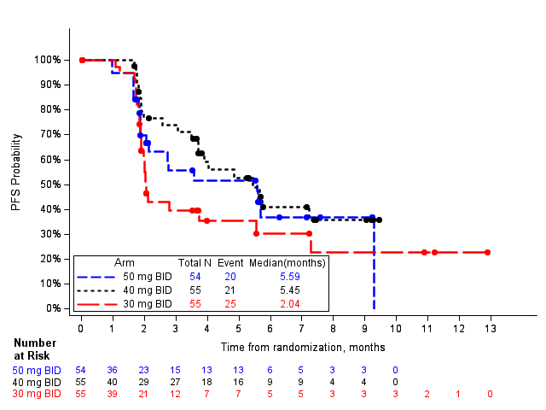
ALISCATM-Breast1 PFS – ITT population
Progression Free Survival

Slide 12
Biomarker

Slide 13
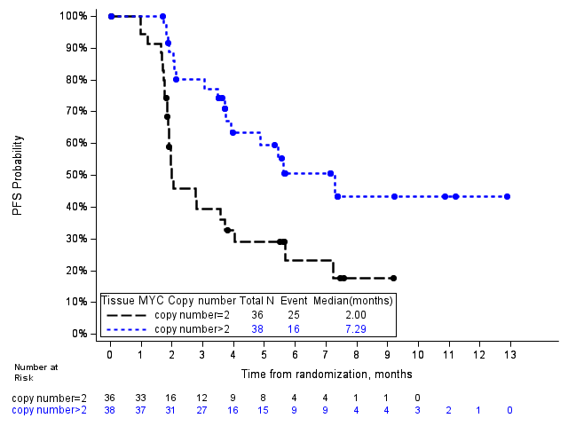
ALISCATM-Breast1 PFS MYC Copy Number

Slide 14
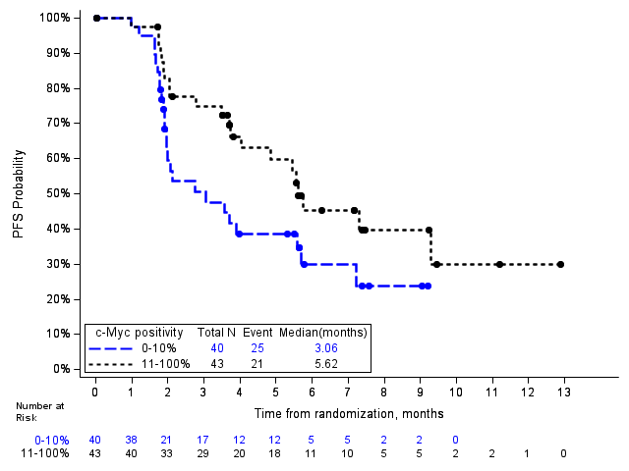
ALISCATM-Breast1 PFS by c-Myc % Positive Cells

Slide 15
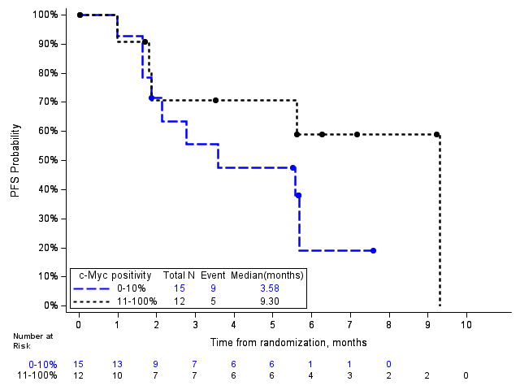
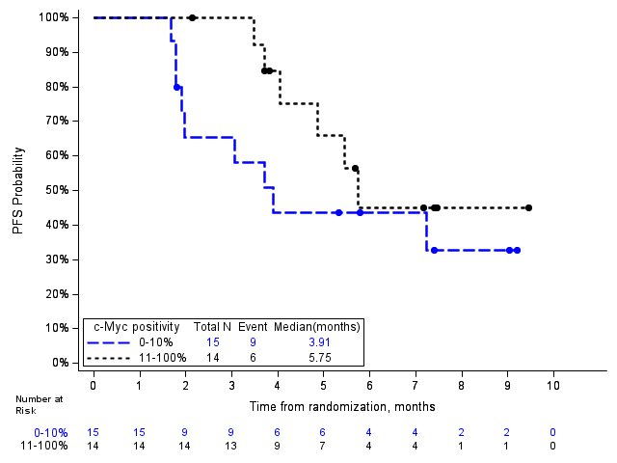
ALISCATM-Breast1 PFS by c-Myc % Positive Cells by Treatment Group
50mg BID
40mg BID

Slide 16
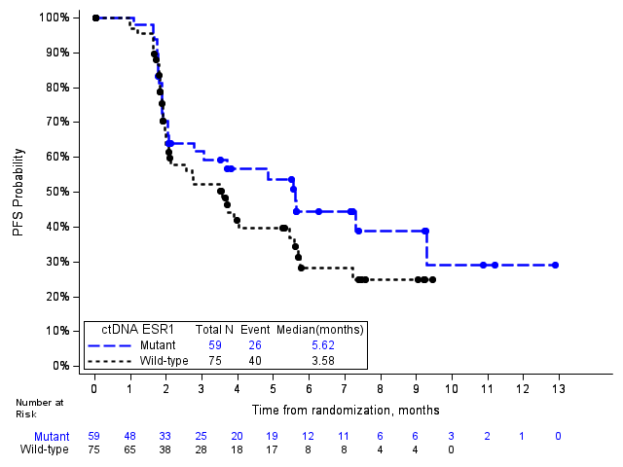
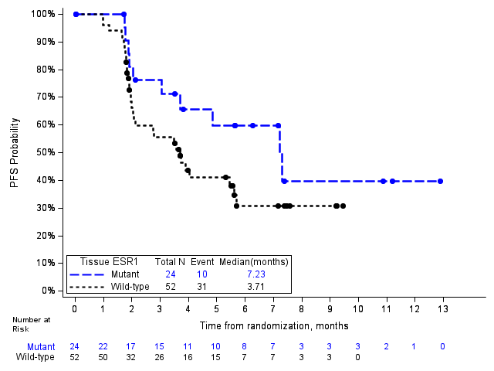
ALISCATM-Breast1 PFS ESR1 Mutation Status
ctDNA
tissue

Slide 17
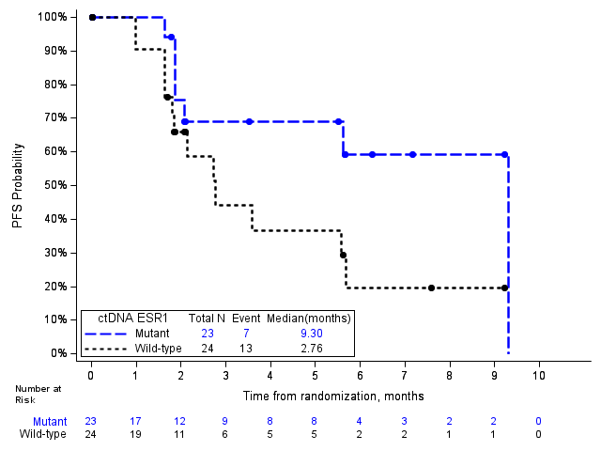
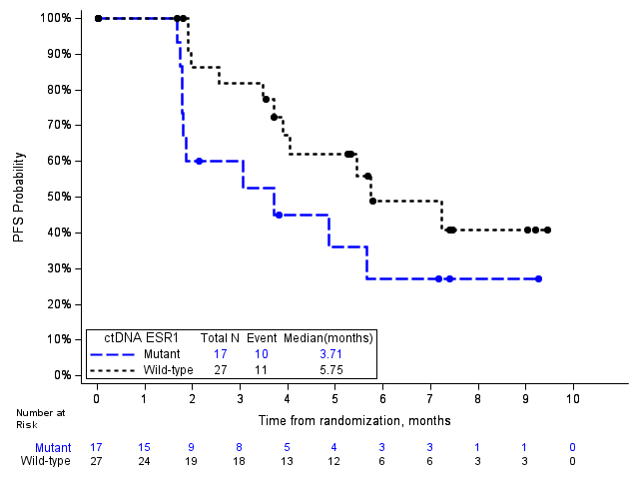
ALISCATM-Breast1 PFS by ESR1 Mutation Status by Treatment Group – ctDNA
50mg BID
40mg BID

Slide 18
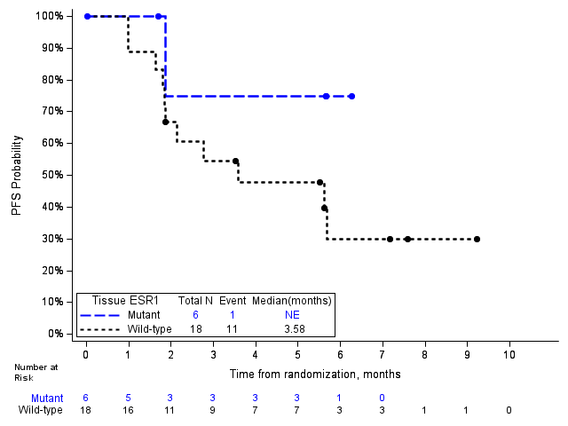
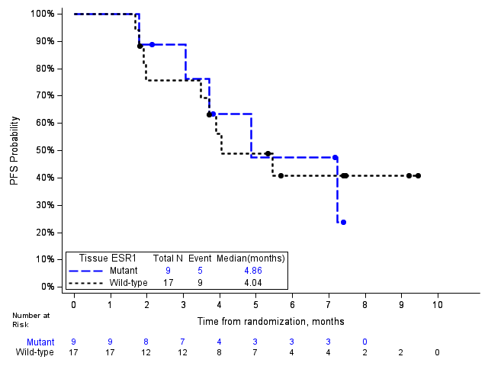
ALISCATM-Breast1 PFS by ESR1 Mutation Status by Treatment Group – Tissue
50mg BID
40mg BID

Slide 19
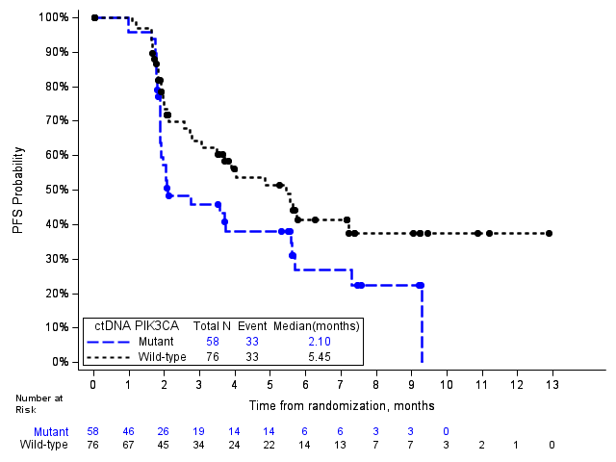
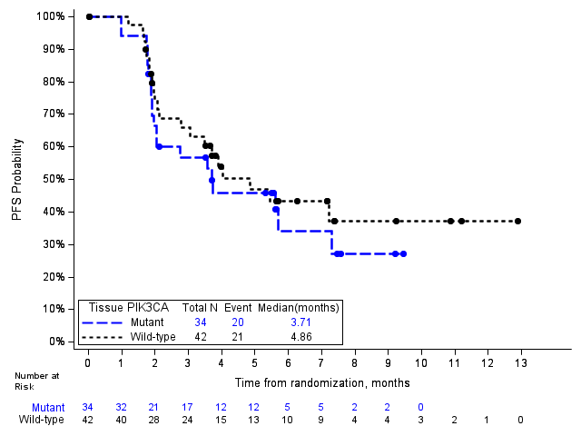
ALISCATM-Breast1 PFS PIK3CA Mutation Status
ctDNA
tissue

Slide 20
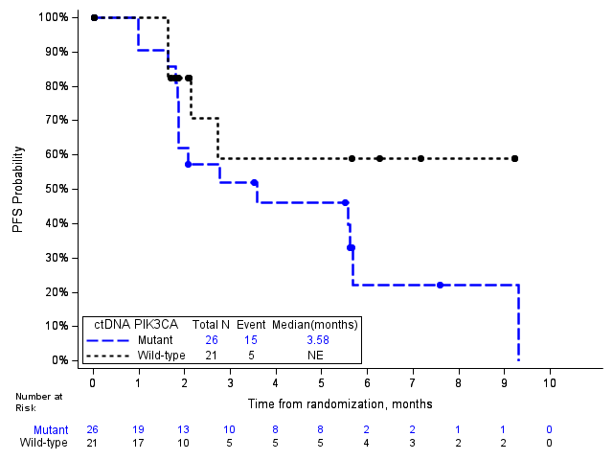
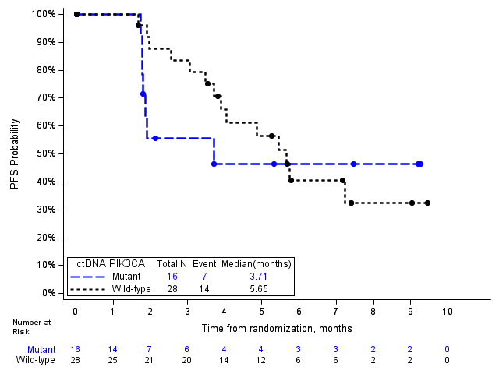
ALISCATM-Breast1 PFS by PIK3CA Mutation Status by Treatment Group – ctDNA
50mg BID
40mg BID

Slide 21
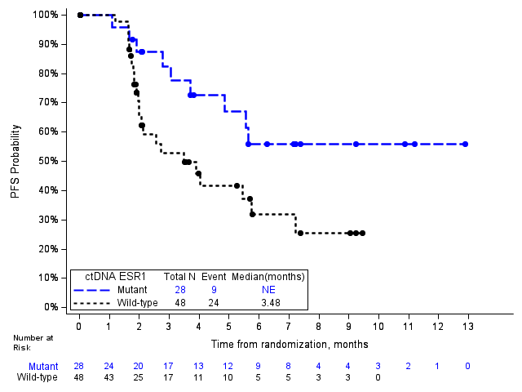
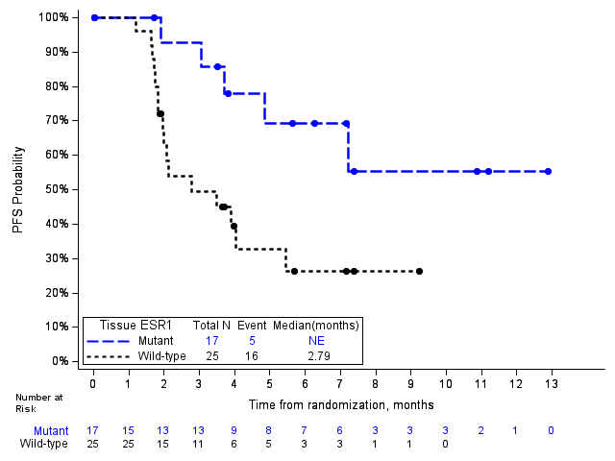
ALISCATM-Breast1 PFS Patients with PIK3CA Wild type by
ESR1 Mutation Status
ctDNA
Tissue

Slide 22
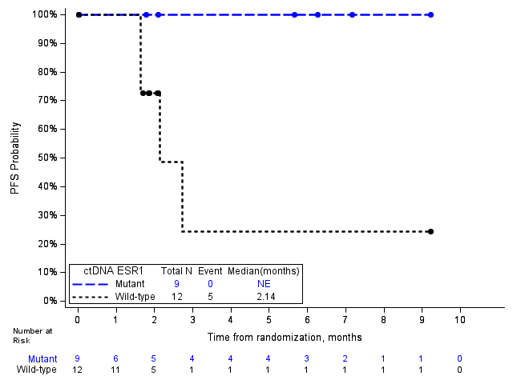
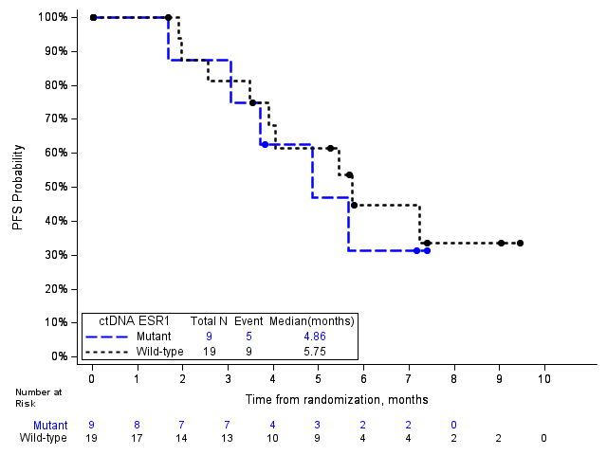
ALISCATM-Breast1 PFS Patients with PIK3CA Wild type by
ESR1 Mutation Status by Treatment Group – ctDNA
50mg BID
40mg BID

Slide 23
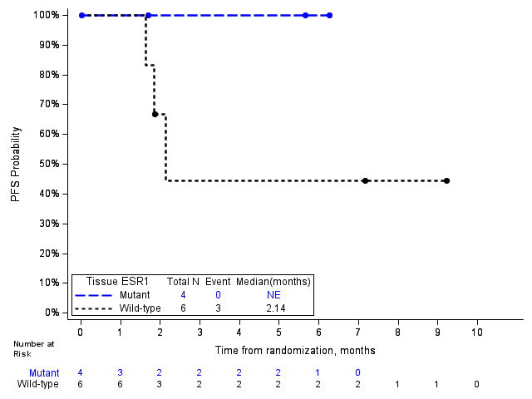
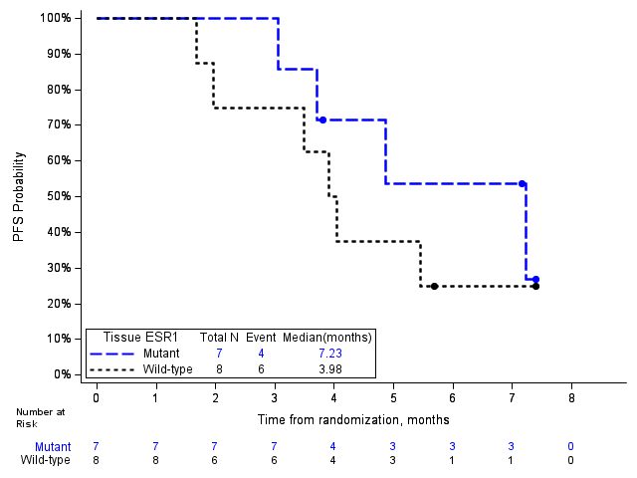
ALISCATM-Breast1 PFS Patients with PIK3CA Wild type by
ESR1 Mutation Status by Treatment Group – Tissue
50mg BID
40mg BID

Slide 24
ALISCATM-Breast1 Patients with ESR1 mut and PIK3CA WT –
Summary of FFPE tissue sample category and c-Myc positive cells
 | Tissue DNA | ctDNA
 | PIK3CA Wild (N=42) | ESR1 Mutant (N=24) | PIK3CA Wild and ESR1 Mutant (N=17) | PIK3CA Wild (N=76) | ESR1 Mutant (N=59) | PIK3CA Wild and ESR1 Mutant (N=28)
c-Myc %positive cells (%) - n | 40 | 23 | 16 | 46 | 33 | 17
Median | 18.5 | 50.0 | 52.5 | 16.0 | 36.0 | 55.0
c-Myc %positive cells Category - n (%)
0% | 6 (14.3) | 2 (8.3) | 1 (5.9) | 7 (9.2) | 3 (5.1) | 1 (3.6)
1-10% | 11 (26.2) | 3 (12.5) | 2 (11.8) | 13 (17.1) | 6 (10.2) | 2 (7.1)
11-100% | 23 (54.8) | 18 (75.0) | 13 (76.5) | 26 (34.2) | 24 (40.7) | 14 (50.0)

Slide 25
Parallel Clinical and Biomarker Development
Comprehensive biomarker strategy supports clinical development and commercialization
Drug development
Enrollment of ALISCATM-Breast1
Amended ALISCATM-Breast1 for biomarker defined population to support potential Phase III trial
Treatment
Data Analysis
biomarker
selection
Biomarker
Analysis or Decision point
Biomarker analysis, batch 1
Biomarker
analysis
Biomarker analysis, batch 2
FDA interaction
Assay development
Pre
validation
IUO
validation
Prospective enrollment/
CDx validation

Slide 26
ALISCATM-Breast1 – Expected Milestones
  Expand enrollment to obtain more data on biomarker directed cohorts (H2 2026)
    PIK3CA Wild Type
    ESR1 Mutant
  Additional interim data from ALISCATM-Breast1, a Phase II clinical trial of alisertib in combination with endocrine therapy for the treatment of ER positive HER2 Negative Metastatic Breast Cancer (H2 2026)

