Slide 1


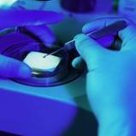

Puma Biotechnology
First Quarter 2026 Earnings Call
May 7, 2026

Slide 2
ALISCATM-Lung1 (PUMA-ALI-4201)
Interim Analysis
May 7, 2026

Slide 3
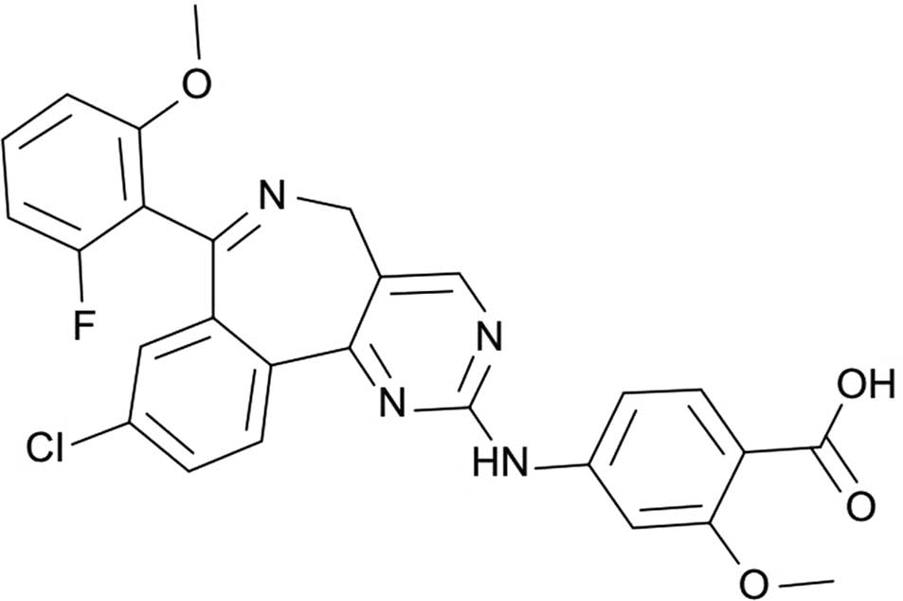
Alisertib (MLN 8237)
Orally Bioavailable
Drug Class: Benzazepine
Aurora Kinase A (AURKA) inhibitor
Single-agent and combinational clinical activity in solid tumors including hormone receptor-positive breast cancer (HR+ MBC), triple negative breast cancer (TNBC), small cell lung cancer (SCLC), and head and neck cancer
Single-agent clinical activity in hematologic malignancies including peripheral T-cell lymphoma (PTCL) and aggressive non-Hodgkin’s lymphoma (NHL)
Well-characterized safety profile: ~1,300 patients treated across 22 company-sponsored trials

Slide 4
AURKA and c-Myc Co-regulate Each Other
Nuclear AURKA exerts kinase-independent functions by acting as a transcription factor
AURKA
c-Myc
Genomic instability & tumor development
AURKA and c-Myc transcriptionally upregulate each other, suggesting the existence of a positive feedback loop
c-Myc upregulates Cyclin D2, CDK4, and cyclin-E, contributing to complex formation and subsequent phosphorylation of p27Kip1, which leads to cell proliferation
E2F1
cyclin-D2
cyclin-E
cdk4
cdk2
P
p27^{klp1}
Cell proliferation
Naso FD Oncogene 2021, Tang A Oncotarget 2017

Slide 5

ALISCATM-Lung1 (PUMA-ALI-4201) Study Design – Alisertib Monotherapy
N = ~55
SCLC
following on or after treatment with one* platinum-based chemotherapy + anti-PDL-1 immunotherapy agent regimen
Original:
Alisertib 50 mg BID on days
1-7 of every 21-day cycle
N = ~35
PD
Amendment 2:
Alisertib 60 mg BID on days
1-7 of every 21-day cycle
N = tbd
Long-term Follow-up
(Survival)
Potential Amendment:
Alisertib 70 mg BID on days
1-7 of every 21-day cycle
* Up to one additional systemic anti-cancer therapy for SCLC is allowed, for a total of up to two prior lines of therapy
Primary prophylaxis with G-CSF following last dose of alisertib of each 21-day cycle and continuing through subsequent cycles
Primary
Determine whether any biomarker correlates with alisertib response by investigator-assessed ORR, DOR, DCR, PFS according to RECIST v1.1 within biomarker-defined subgroups from retrospectively evaluated patient samples
Secondary
Determine investigator-assessed efficacy (ORR, DOR, DCR and PFS) according to RECIST v1.1
Determine survival outcomes (OS)
Determine the safety profile of alisertib (AE and SAEs per NCI CTCAE v 5.0)
Study objectives and endpoints

Slide 6
ALISCATM-Lung1 SCLC History and Baseline Characteristics
 | 50 mg BID (N=52) | 60 mg BID (N=27) | Total (N=79)
VALSG stage at initial diagnosis - n (%)
Limited | 7 (13.5) | 6 (22.2) | 13 (16.5)
Extensive | 45 (86.5) | 20 (74.1) | 65 (82.3)
ECOG performance status at C1D1 – n (%)
0 | 16 (30.8) | 10 (37.0) | 26 (32.9)
1 | 34 (65.4) | 17 (63.0) | 51 (64.6)
2 | 2 (3.8) | 0 | 2 (2.5)
Tobacco smoking – n (%)
Current | 13 (25.0) | 3 (11.1) | 16 (20.3)
Never | 2 (3.8) | 2 (7.4) | 4 (5.1)
Former | 37 (71.2) | 22 (81.5) | 59 (74.7)
Location of disease at enrollment – n (%)
Visceral | 47 (90.4) | 21 (77.8) | 68 (86.1)
Not Visceral | 5 (9.6) | 3 (11.1) | 8 (10.1)
Missing | 0 | 3 (11.1) | 3 (3.8)
Location of disease in the brain – n (%)
Yes | 21 (40.4) | 9 (33.3) | 30 (38.0)
No | 31 (59.6) | 15 (55.6) | 46 (58.2)
Location of disease in the liver – n (%)
Yes | 25 (48.1) | 13 (48.1) | 38 (48.1)
No | 27 (51.9) | 11 (40.7) | 38 (48.1)

Slide 7
ALISCATM-Lung1 Summary of Prior Anti-cancer Therapy
Prior anti-cancer therapy | 50 mg BID (N=52) | 60 mg BID (N=27) | Total (N=79)
Prior radiotherapy – n (%)
No | 16 (30.8) | 12 (44.4) | 28 (35.4)
Yes | 36 (69.2) | 15 (55.6) | 51 (64.6)
Prior cancer-related surgery – n (%)
No | 44 (84.6) | 25 (92.6) | 69 (87.3)
Yes | 8 (15.4) | 2 (7.4) | 10 (12.7)
Prior anti-cancer medication – n (%)
No | 0 | 1 (3.7) | 1 (1.3)
Yes | 52 (100.0) | 26 (96.3) | 78 (98.7)
Prior platinum based chemotherapy | 52 (100.0) | 24 (92.3) | 76 (97.4)
Prior immunotherapy | 52 (100.0) | 24 (92.3) | 76 (97.4)
Prior number of treatment regimens – n (%)
1 | 40 (76.9) | 16 (59.3) | 56 (70.9)
2 | 12 (23.1) | 10 (37.0) | 22 (27.8)

Slide 8
Safety

Slide 9
ALISCATM-Lung1 Incidence of TEAEs – All Grades
 | 50 mg BID (N=52) | 60 mg BID (N=27) | Total (N=79)
Subjects with at Least 1 Reported AE - n (%) | 21 (40.4) | 19 (70.4) | 40 (50.6)
Neutropenia | 10 (19.2) | 6 (22.2) | 16 (20.3)
Febrile neutropenia | 2 (3.8) | 2 (7.4) | 4 (5.1)
Thrombocytopenia | 4 (7.7) | 4 (14.8) | 8 (10.1)
Anemia | 15 (28.8) | 7 (25.9) | 22 (27.8)
Diarrhea | 12 (23.1) | 11 (40.7) | 23 (29.1)
Stomatitis | 8 (15.4) | 9 (33.3) | 17 (21.5)
Somnolence | 1 (1.9) | 1 (3.7) | 2 (2.5)

Slide 10
ALISCATM-Lung1 Incidence of Grade 3 or 4 TEAEs
 | 50 mg BID (N=52) | 60 mg BID (N=27) | Total (N=79)
Subjects with at least one reported AE - n (%) | 12 (23.1) | 7 (25.9) | 19 (24.1)
Neutropenia | 7 (13.5) | 3 (11.1) | 10 (12.7)
Febrile neutropenia | 2 (3.8) | 2 (7.4) | 4 (5.1)
Thrombocytopenia | 2 (3.8) | 1 (3.7) | 3 (3.8)
Anemia | 8 (15.4) | 4 (14.8) | 12 (15.2)
Diarrhea | 0 | 0 | 0
Stomatitis | 1 (1.9) | 3 (11.1) | 4 (5.1)
Somnolence | 0 | 0 | 0

Slide 11
ALISCATM-Lung1 Incidence of Grade 3 or 4 TEAEs
Compared to Study C14007
 | C14007 Alisertib monotherapy 50 mg BID 7D (n=60)¹ | PUMA-ALI-4201 Alisertib monotherapy 50 mg BID 7D (n=52)² | PUMA-ALI-4201 Alisertib monotherapy 60 mg BID 7D (n=27)²
Subjects with at least one reported AESI - n (%) | 28 (46.7) | 12 (23.1) | 7 (25.9)
Neutropenia | 22 (36.7) | 7 (13.5) | 3 (11.1)
Febrile neutropenia | 5 (8.3) | 2 (3.8) | 2 (7.4)
Thrombocytopenia | 9 (15.0) | 2 (3.8) | 1 (3.7)
Anemia | 11 (18.3) | 8 (15.4) | 4 (14.8)
Diarrhea | 2 (3.3) | 0 | 0
Stomatitis | 4 (6.7) | 1 (1.9) | 3 (11.1)
Somnolence | 1 (1.7) | 0 | 0
¹Data on file. SCLC subjects only ²Source: Data Extract

Slide 12
Efficacy

Slide 13
ALISCATM-Lung1 Summary of Clinical Benefit (Subjects with at Least One Post-baseline Scan or Ended Treatment Prior to First Scan)
Response, n (%) | 50 mg BID (N=52) | 60 mg BID (N=15)
Best overall response
Complete response (CR) | 0 | 0
Partial response (PR) | 6 (11.5) | 1 (6.7)
Stable disease (SD) | 18 (34.6) | 7 (46.7)
Disease progression (PD) | 22 (42.3) | 2 (13.3)
Not evaluable (NE) | 1 (1.9) | 0
Unavailable* | 5 (9.6) | 5 (33.3)
Clinical benefit - n (%)
Confirmed complete response (CR) | 0 | 0
Confirmed partial response (PR) | 3 (5.8) | 1 (6.7)
Stable disease >= 12 weeks (SD) | 19 (36.5) | 2 (13.3)
Objective response (Confirmed CR or PR) – n(%) | 3 (5.8) | 1 (6.7)
Disease control rateª (95% CI) | 42.3 (28.7, 56.8) | 20.0 (4.3, 48.1)
Median duration of response (months) | 4.2 | NA
Median PFS (months) | 1.7 | 4.2
*Unavailable are subjects who ended treatment or died prior to any on-treatment scan
Best overall response (BOR) is not confirmed.
ªDCR=CR+PR+SD ≥ 12 wks

Slide 14
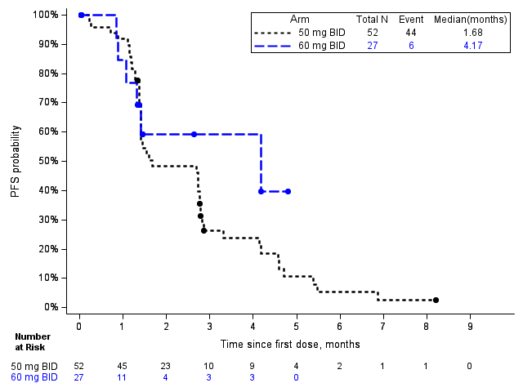
ALISCATM-Lung1 PFS – ITT Population by Treatment Group
Progression Free Survival

Slide 15
Biomarkers

Slide 16
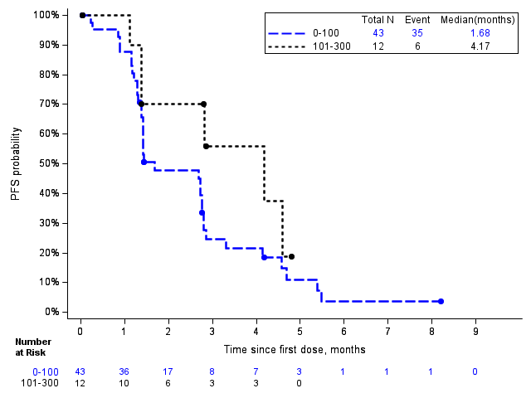
ALISCATM-Lung1 PFS by c-Myc H-score
Total

Slide 17
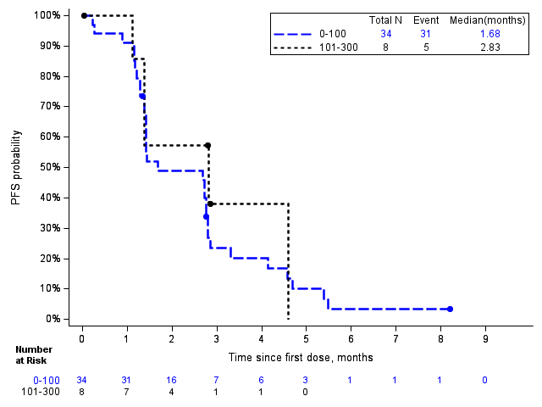
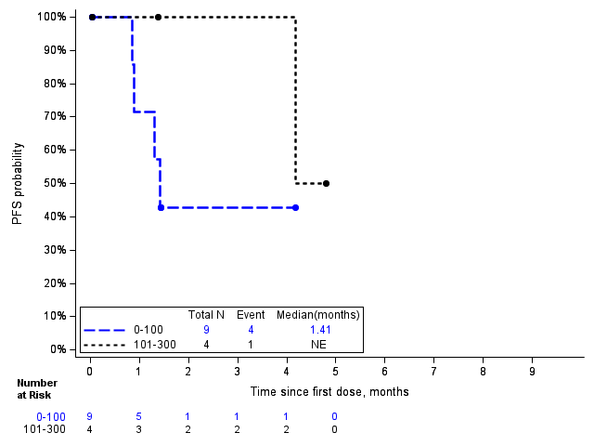
ALISCATM-Lung1 PFS by c-Myc H-score by Treatment Group
50 mg BID
60 mg BID

Slide 18
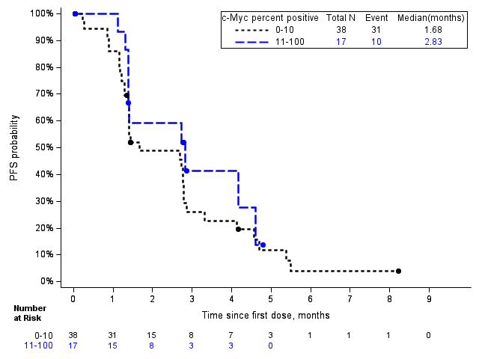
ALISCATM-Lung1 PFS by c-Myc % Positive Cells

Slide 19
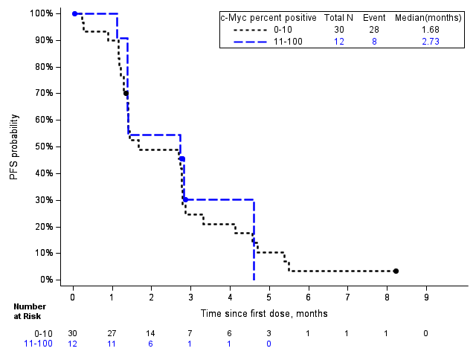
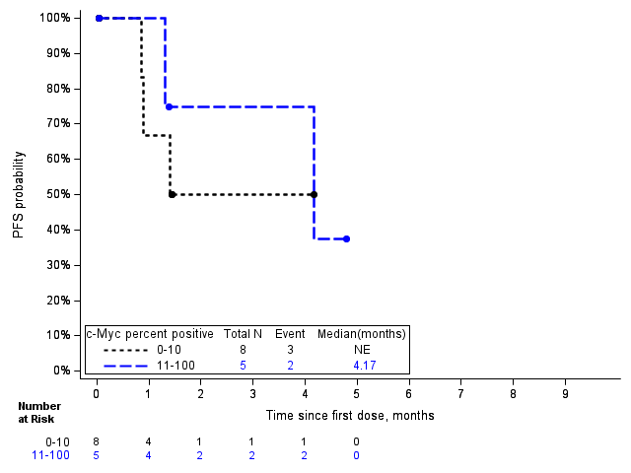
ALISCATM-Lung1 PFS by c-Myc % Positive Cells by Treatment Group
50 mg BID
60 mg BID

Slide 20
ALISCATM-Lung1 – Expected Milestones
  Initiate enrollment of 70 mg BID monotherapy cohort in ALISCATM-Lung1(H2 2026)
  Initiate enrollment of ALISCATM Lung2 – Phase I/II trial of alisertib in combination with paclitaxel (H2 26)
  Additional interim data from ALISCATM-Lung1, a Phase II clinical trial of alisertib monotherapy for the treatment of extensive-stage small cell lung cancer (H2 2026/H1 2027)

