Slide 1
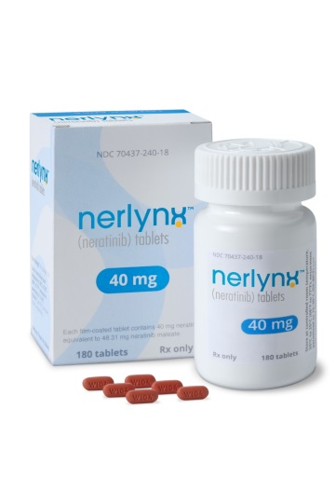

Puma Biotechnology
Earnings Call
Commercial Update
November 6, 2019
Copyright 2019 Puma Biotechnology

Slide 2
Forward-Looking Safe Harbor Statement
This presentation contains forward-looking statements, including statements regarding the timing of expected launch and expected regulatory approvals for NERLYNX®. All statements other than historical facts are forward–looking statements and are based on the current expectations, forecasts and assumptions of Puma Biotechnology, Inc. (“Puma”). Forward–looking statements involve risks and uncertainties that could cause Puma’s actual results to differ materially from the anticipated results and expectations expressed in these forward-looking statements. These risk and uncertainties are identified in Puma’s Annual Report on Form 10-K for the year ended December 31, 2018 and any subsequent documents Puma files with the Securities and Exchange Commission. You are cautioned not to place undue reliance on these forward-looking statements, which speak only as of the date hereof, and you should not rely on these forward-looking statements as representing Puma’s views as of any date subsequent to the date of this presentation. Puma assumes no obligation to update these forward-looking statements, except as required by law.
Copyright 2019 Puma Biotechnology

Slide 3


Puma’s Pharmacy and Distributor Network
Hub Services
Specialty Pharmacy Network
Acaria Health
Accredo
CVS
Onco360
Diplomat
Biologics
Patients
Sites of Care
Academic Hospitals
Community Hospitals
Specialty Distributor Network
Physician Practices
Other (VA, DoD)
McKesson
ASD / Oncology Supply
Cardinal Health
Copyright 2019 Puma Biotechnology

Slide 4
$53.5 Million Net Revenue in Q3 2019
Copyright 2019 Puma Biotechnology

Slide 5
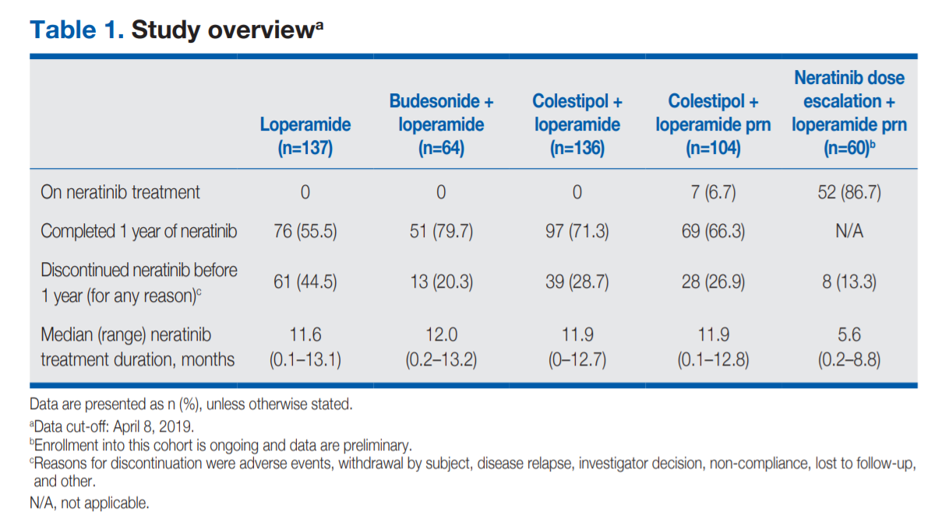
From CONTROL Poster Presented at ASCO 2019

Slide 6
18% of Patients in Q3 Started NERLYNX at a Reduced Dose
Reduced Dose defined as fewer than 6 pills per day
Copyright 2019 Puma Biotechnology

Slide 7
Bottles Sold By Quarter
SP = Specialty Pharmacy Network, SD = Specialty Distributor Network
Copyright 2019 Puma Biotechnology

Slide 8






Rest of World Partnerships – Timelines
Region | Partner | Expected Regulatory Approval
Australia / SE Asia |  | March 2019 – Approved in Australia
Israel |  | Q4 2019
Canada |  | July 2019 – Approved
Greater China |  | November 2019 – Approved in Hong Kong 1H 2020 – China 1H 2020 – Taiwan
Latin America South America |  | September 2019 – Approved in Argentina 1H 2020 – Chile, Peru 2H 2020 – Mexico 2H 2020 – Colombia, Brazil, Ecuador
Europe |  | Launch Timelines Q4 2019 – Germany Q4 2019 – United Kingdom Q4 2019 – Austria 2020-2022– Rest of Europe
Copyright 2019 Puma Biotechnology

Slide 9
Puma Biotechnology
Earnings Call
Commercial Update
November 6, 2019
Copyright 2019 Puma Biotechnology

