Slide 1
Puma Biotechnology
SUMMIT Trial
Update on Regulatory Strategy
November 6, 2019
Copyright 2019 Puma Biotechnology

Slide 2
Forward-Looking Safe Harbor Statement
This presentation contains forward-looking statements, including statements regarding ongoing clinical studies and potential regulatory approvals for NERLYNX®. All statements other than historical facts are forward–looking statements and are based on the current expectations, forecasts and assumptions of Puma Biotechnology, Inc. (“Puma”). Forward–looking statements involve risks and uncertainties that could cause Puma’s actual results to differ materially from the anticipated results and expectations expressed in these forward-looking statements. These risk and uncertainties are identified in Puma’s Annual Report on Form 10-K for the year ended December 31, 2018 and any subsequent documents Puma files with the Securities and Exchange Commission. You are cautioned not to place undue reliance on these forward-looking statements, which speak only as of the date hereof, and you should not rely on these forward-looking statements as representing Puma’s views as of any date subsequent to the date of this presentation. Puma assumes no obligation to update these forward-looking statements, except as required by law.
Copyright 2019 Puma Biotechnology

Slide 3
Current SUMMIT ‘Basket’ Trial: Study Design
EGFR exon18- mutant tumors
Lung
Neratinib monotherapy
Primary endpoint
Objective response rate at first post-baseline
tumor assessment (ORR_{first})
Secondary endpoints
ORR (confirmed)
Clinical benefit rate (CBR)
Progression-free survival (PFS)
Safety
Biomarkers
Simon 2-stage design
If ≥1 response in first evaluable 7 patients,
expand cohort to Stage 2 (N=18)
If ≥4 responses in Stage 2, expand or breakout
Tumor assessments
RECIST v1.1 (primary criteria)
PET response criteria (RECIST non-evaluable)
Statistical methods
ORR_{first}, ORR, CBR: associated 95% CI
Median PFS: Kaplan-Meier estimate with 95% CI
EGFR, HER2 or HER4 mutations
(documented by local testing)
Cervical
Salivary gland
Neratinib monotherapy
Solid tumors (NOS)
HER2-mutant
tumors
Bladder
Neratinib + Paclitaxel
Breast HRc-positive*
Neratinib* + Trastuzumab#
Breast HRc-negative
*plus fulvestrant (in ER+ breast)
#biosimilar may be used if available
HER4-mutant
tumors
Solid tumors (NOS)
Neratinib monotherapy
Histologically confirmed cancers for which no curative therapy exists
Documented EGFR exon 18, HER2 or HER4 mutation
ECOG status of 0 to 2
RECIST 1.1 evaluable disease (measurable or non-measurable disease): if RECIST non-measurable, evaluable by other accepted criteria
Prior treatment with any pan-HER TKI (eg, lapatinib, afatinib, dacomitinib, neratinib)
Patients who are receiving any other anticancer agents
Symptomatic or unstable brain metastases
Women who are pregnant or breast-feeding
Key Inclusion Criteria
Key Exclusion Criteria
Clinical Trials.gov Identifier NCT01953926

Slide 4
SUMMIT
Hormone Receptor Positive Breast Cancer Cohort
Copyright 2019 Puma Biotechnology
4

Slide 5
Somatic Mutations in HER2 (ERBB2) in Hormone Receptor Positive Breast Cancer
Incidence:
- 7-9%, pre-treated ER+ MBC¹
Tumor characteristics:
- usually mutually exclusive to HER2 amplifications
Preclinical evidence of oncogenic activity:
constitutive activation of intracellular kinase and downstream signaling pathways²
increased cell proliferation and tumor growth²
Cross-talk occurs between ER and HER2 mutation (modified SUMMIT trial to add fulvestrant to ER positive patients)
HER2 amplification seen as potential mechanism of resistance to neratinib plus fulvestrant (modified SUMMIT trial to add trastuzumab to neratinib plus fulvestrant in ER positive patients)
HER2 somatic mutations
P
P
P
P
P
PI3K
RAS
PI3K Pathway
MAPK Pathway
AKT
RAF
MEK
mTOR
ERK
Nucleus
↑ Cell cycle control and proliferation
↑ Cell survival and decreased apoptosis
↑ Cellular migration and metastasis
↑ Angiogenesis
Copyright 2019 Puma Biotechnology
¹Wagle et al, ASCO 2016; ²Bose et al, Cancer Disc. 2013

Slide 6
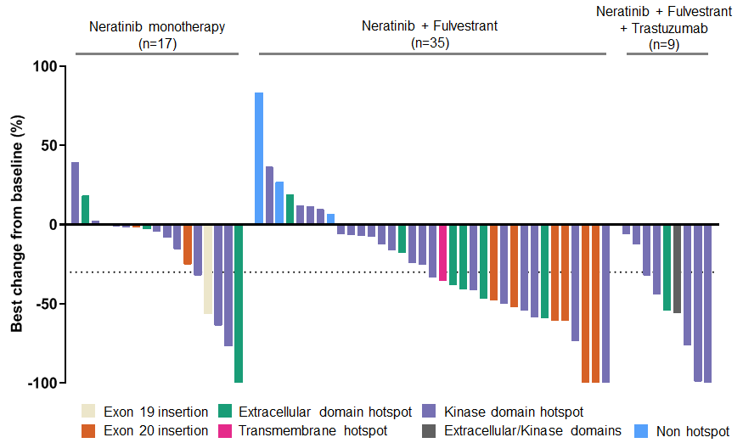
Maximal Change in Tumor in RECIST Measurable HR positive/HER2-negative, HER2mut MBC Subjects Receiving Neratinib Monotherapy, N+F, or N+F+T and Grouped by Treatment Type and HER2mut Type
Copyright 2019 Puma Biotechnology
Notes:
Note: 1 patient in the neratinib monotherapy cohort (n=17) and 2 patients in the N+F cohort (n=35) are not shown because they did not have a postbaseline target lesion measurement available.

Slide 7
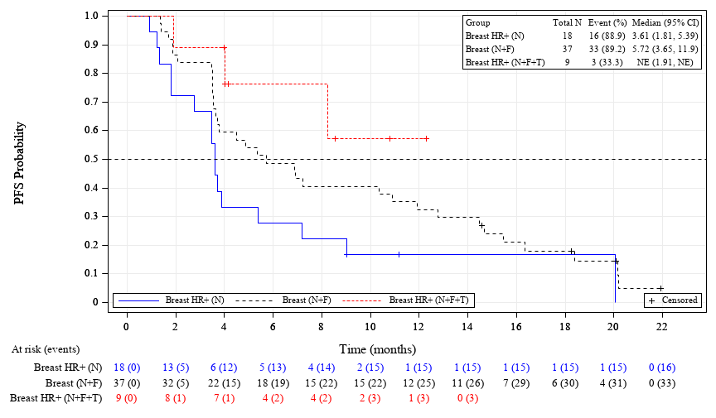
Kaplan Meier Plot of Progression Free Survival for Breast Cancer Cohorts in SUMMIT (Efficacy Evaluable Population - HR positive/HER2-negative, HER2mut MBC Cohort and with RECIST Tumor Assessment)
Copyright 2019 Puma Biotechnology
Notes:
Note: 1 patient in the neratinib monotherapy cohort (n=17) and 2 patients in the N+F cohort (n=35) are not shown because they did not have a postbaseline target lesion measurement available.

Slide 8
Proposed Amendment to Breast Cancer Cohort in SUMMIT for
HR positive/HER2-negative, HER2mut MBC Cohort to
Support Accelerated Approval
Primary endpoint
Objective response rate
Secondary endpoints
DOR
Simon 2-stage design
Proposed assessment criteria consistent with original design
If ≥1 response in first evaluable 7 patients,
expand cohort to Stage 2 (N=18)
If ≥4 responses in Stage 2, expand or breakout
Tumor assessments
RECIST v1.1 (primary criteria)
HER2 mutations
(documented by local testing)
fulvestrant
Randomized 1:1:1
fulvestrant + trastuzumab
fulvestrant + trastuzumab +
Neratinib
Puma to schedule pre NDA meeting with FDA after initial Simon 2 stage results to discuss potential for accelerated approval (anticipated Q4 2020-Q2 2021)
Copyright 2019 Puma Biotechnology
Notes:
Note: 1 patient in the neratinib monotherapy cohort (n=17) and 2 patients in the N+F cohort (n=35) are not shown because they did not have a postbaseline target lesion measurement available.

Slide 9
SUMMIT
Cervical Cancer Cohort
Copyright 2019 Puma Biotechnology
9

Slide 10

Characteristics of HER2 Mutant Cervical Cancer
Incidence
Histology
Genomics
5% - Metastatic cervical
cancers
May be negatively prognostic
for survival
Enriched in adenocarcinomas
High occurrence in HPV+
tumors
Most common HER2^{mut} is
S310 extracellular domain
hotspot mutation
Usually exclusive to
HER2 amplifications
Most common co-mutations
include TP53, PIK3CA

Slide 11
Neratinib Monotherapy Results Presented at SGO Meeting
Copyright 2019 Puma Biotechnology
Notes:
Note: 1 patient in the neratinib monotherapy cohort (n=17) and 2 patients in the N+F cohort (n=35) are not shown because they did not have a postbaseline target lesion measurement available.

Slide 12
Neratinib Monotherapy Results Presented at SGO Meeting
Copyright 2019 Puma Biotechnology
Notes:
Note: 1 patient in the neratinib monotherapy cohort (n=17) and 2 patients in the N+F cohort (n=35) are not shown because they did not have a postbaseline target lesion measurement available.

Slide 13
Path Forward
SUMMIT study to enroll additional patients with HER2 mutated cervical cancer
Monotherapy data can be used to file for accelerated approval
  Overall response rate
  Duration of response
Puma to schedule pre NDA meeting with FDA (anticipated Q4 2020-Q2 2021)

Slide 14
HER-Seq (PUMA-NER-9501):
HER2 mutation screening protocol

Slide 15
Why HER-Seq?
1
Rarity of HER2 mutation warrants an active screening program
Lack of access to genomic testing
Ex-US regions
2
3
Liquid biopsy is non-invasive and convenient
Also facilitates repeat sampling
4
Tracked by Puma from clinical presentation to neratinib trial eligibility
HER-Seq fills a need for inexpensive, high-throughput HER2 genomic sequencing

Slide 16


HER-Seq (PUMA-NER-9501) Study Protocol
HER-Seq: A Blood-based Screening Study to Identify Patients with HER2 Mutations for Enrollment into SUMMIT (initiated December 2018)
HER2 mutation positive
Consider
screening for
neratinib
treatment
protocol
PROTOCOL
CONSENT FOR SCREENING
Retest in
3-6 months
HER2
mutation proprietary sequencing test performed
Test result reported to physician and sponsor within 2-4 weeks
HER2
wild type
Metastatic
breast or
cervical
cancer patient
Patient consented
Blood
sample
collected
Sample
shipped
to central lab
Women and men who are ≥18 years old at signing
of informed consent.
Histologically-confirmed metastatic breast or
cervical cancer
ECOG status of 0 to 2
Provide written, informed consent to participate in
the study and for circulating tumor DNA screening
Must provide blood sample(s) for HER2 mutation testing
Patients with known HER2+ or HER2-amplified tumors
Patients who have received neratinib or any other prior EGFR/HER2 tyrosine kinase inhibitor
PRIMARY OBJECTIVE:
To identify patients with HER2 mutations who may be eligible for screening into
the SUMMIT ‘basket’ trial or other
disease-specific neratinib
treatment protocol.
Key Inclusion Criteria
Key Exclusion Criteria
Clinical trials.gov NCT: NCT03786107

Slide 17
HER-Seq Trial
Currently open at ~15 sites
  Being expanded to other SUMMIT sites
Utilizes proprietary next generation sequencing assay for HER2 mutations
Screening Goals:
Breast cancer: Screen 2500 patients
Cervical cancer: Screen 1200 patients
Patients with HER2 mutations identified through HER-Seq will
be considered for enrollment in SUMMIT

Slide 18
SUMMIT Trial
Proposed Registration Pathway
Meet with FDA to discuss registration pathway in HR-positive, HER2 negative HER2 mutated breast cancer and HER2 mutated cervical cancer
Modify SUMMIT trial to expand HER2 mutated breast cancer cohort
Continue to enroll HER2 mutated cervical cancer cohort
Expand HER-Seq to expedite enrollment in SUMMIT
Puma R&D budget decrease due to declines in expenses associated with ExteNET, NALA, CONTROL will open up opportunity to expand SUMMIT
Meet with FDA for pre-NDA meeting anticipated Q4 2020-Q2 2021

